Slide 1
The Miracles of Jesus John 6:1-15
Preached by Rev. Manik Corea at Crossroads International Church Singapore • CICFamily.com Uploaded by Dr. Rick Griffith • Jordan Evangelical Theological Seminary Files in many languages for free download at BibleStudyDownloads.org

Slide 2
Miracles: “Unusual workings of God that are clearly supernatural.” (Theologian Millard Erickson)

Slide 3
The Purpose of Miracles
What are the purposes of miracles?
1. To glorify God – he is always the source of the miraculous (Matt 9:8, 15:31; Mark 2:12b; Luke 17:15).
2. To affirm the supernatural basis of revelation. They confirm the message about Jesus. Greek word often used for miracles – ‘signs’ (John 14:11; Mark 16:20; Heb 2:4).
3. To meet human needs. Jesus’ miracles are a result of his compassion for the suffering and the lost. (Mark 1:41; Matt 14:14, 20:34).
Adapted from Millard Erickson, Christian Theology (Baker, 2004),434

Slide 4
The Purpose of Miracles
Context of John 6:1-15
The 7 miraculous signs of John
1) Water into wine (John 2:1-11)
2) The healing of the official’s son (John 4:46-54)
3)The healing at the pool of Bethesda (John 5:1-17)
4) Feeding of the 5,000 (John 6:1-15)
5) Walking on water (John 6:16-21)
6) The healing of the blind man from birth (John 9:1-41)
7) The raising of Lazarus from the dead (John 11:1-44)

Slide 5
The Purpose of Miracles
7 ‘I AM’ Sayings
1. I am the Bread of Life (John 6:35)
2. I am the Light of the World (John 8:12)
3. I am the Door (John 10:9)
4. I am the Good Shepherd (John 10:11-14)
5. I am the Resurrection and the Life (John 11:25)
6. I am the Way and the Truth and the Life (John 14:6)
7. I am the Vine (John 15:1-5)

Slide 6
The Purpose of Miracles
7 Witnesses to Jesus
1) John the Baptist - John 1:29-34
2) Nathaniel - John 1:43-51
3) Peter - John 6:66-69
4) Jesus himself - John 10:22-30
5) Martha - John 11:27
6) Thomas - John 20:28
7) John - John 20:30-31

Slide 8
The Purpose of Miracles
Text of John 6:1-15
Vs 1-4 – Jesus is the bread of life, the Passover Lamb (John 6:35; 48-58)
Vs 5-9 – Right answer, wrong question.
Great hunger, little meal.
Vs 10-13 – Faith exercised before food provided.
Food enough for others.

Slide 9
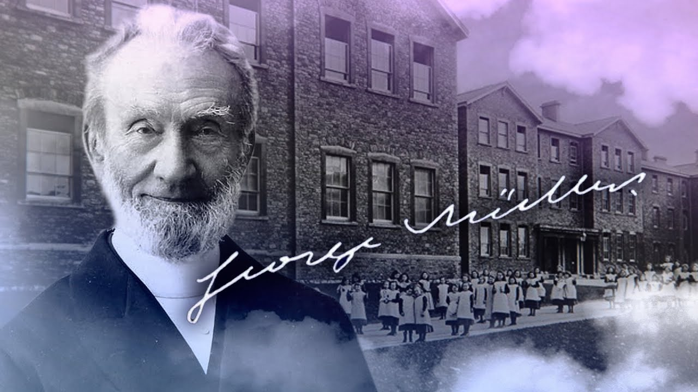
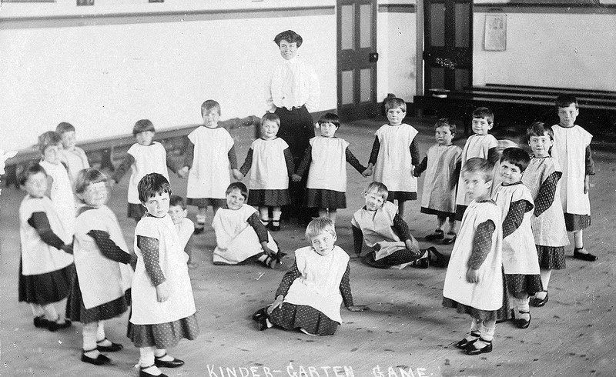
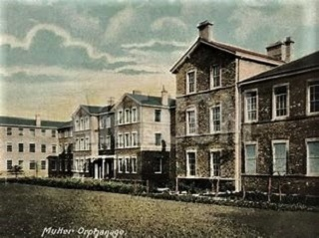

Slide 10
The Purpose of Miracles
Text of John 6:1-15
Vs 1-4 – Jesus is the bread of life, the Passover Lamb (John 6:35; 48-58)
Vs 5-9 – Right answer, wrong question.
Great hunger, little meal.
Vs 10-13 – Faith exercised before food provided.
Food enough for others.

Slide 11
The Purpose of Miracles
Text of John 6:1-15
Vs 1-4 – Jesus is the bread of life, the Passover Lamb (John 6:35; 48-58)
Vs 5-9 – Right answer, wrong question.
Great hunger, little meal.
Vs 10-13 – Faith exercised before food provided.
Food enough for others.
Vs 14-15 – Crowd wanted to forcefully make Jesus king but he would not let them.

Slide 12
APPLICATION
1. Where do we go to find bread for the hungry?
2. Look past the miracle – behold Jesus!
3. Don’t come to him with your agenda. Bow down, surrender your life, worship Him!

Slide 13
Black

Slide 14
NT Preaching link at BibleStudyDownloads.org
Get this presentation and script for free!
Notes:
NT Preaching (np)

